Slide 1
INFORMED SEARCH

Slide 2

Heuristic Search: Algorithms
Best First Search
A* Search
AO* Search

Slide 3
Informed Search:
Best-first searching
A best-first search depends on the use of a heuristic to select the most promising path to a goal node.
Best first search selects the next node based on the best estimate out of all the estimates of the heuristic function calculated so far – this is where Best-First Search differs from Hill Climbing.
For example, in a tree in which the heuristic function calculates the cost of reaching the goal node from the current node, the best node to choose is the one with the minimum cost.

Slide 4
Best First Search: Algorithm
Place the starting node s in the queue.
If the queue is empty, return failure and stop.
If the first element in the queue is a goal state g, return success and stop.
Otherwise, remove the first element from the queue, expand it and compute the estimated goal distances for each child. Place the children on the queue (at either end) and arrange all queue elements in ascending order corresponding to goal distance from the front of the queue.
Return to step 2.

Slide 5
Best First Search:
Dry run
Queue
Tree
Front Initial State: A Tail
A
A-20
Expand A and arrange in Asc order of cost
C | B
B-15
C-10
Expand C (front)
D-8
E-6
F-0
F
The goal F is found

Slide 6
Difference between Hill climbing and Best first search
In hill climbing, all successors of the current node are compared and the closest to the solution is chosen. In best-first search, all the nodes searched so far are compared to select the best node.
In hill-climbing, the current node's children are sorted before adding them to the queue. In best-first search, the current node's children are added to the queue in any order, then the entire queue is sorted.

Slide 7
A* Search
A specialization of Best-First Search
The procedure followed by A* Search is:
  Along a path to the goal, at each node, the A* algorithm generates all the child nodes,
  For each child node, A* computes the estimate of the distance (cost) from the start node to a goal node through each of the children,
  A* selects the child node which has the minimum cost and expands it. The process then repeats for this selected node until the goal is found or the search ends in failure.

Slide 8
A* Search
The total cost function f(n) used by A*, for the current node n during the search process is given by
f(n)=g(n) + h(n),
where, g(n) = the cost of reaching the node n from the root of the tree,
and, h(n) = heuristic function used to estimate the cost of completing the processing task at node n.
The list OPEN stores the nodes which have been generated but not expanded and are available (are “open”) for expansion, that is, their child nodes are yet to be identified.
The list CLOSED stores the nodes that have been expanded and are not available (are “closed”) for further expansion.

Slide 9
A* Search: Issues
When will a node have to be moved from CLOSED to OPEN?
  This is required only in the case when the data structure being used for the search is a graph rather than a tree.
  In the case of a graph, the moving of a node from CLOSED to OPEN indicates a backtracking and that the path followed till the node being moved is not the best path and there are other alternative paths which may be better.

Slide 10
A* Search: Algorithm
Initialize: Set OPEN={s}, CLOSED={ },
g(s)=0 and f(s)=h(s).
Fail: if OPEN={ }; terminate and fail.
Select: Select the minimum cost state, n from OPEN. Save n in CLOSED.
Terminate: If n ∈ G, where G is the set of goal states, terminate with success and return f(n).

Slide 11
A* Search: Algorithm
Expand: For each child, m, of n
if m ∉ [OPEN ∪ CLOSED]
Set g(m) = g(n) + C(n, m)
Set f(m) = g(m) + h(m)
Insert m in OPEN. C(n, m) is the cost of moving from node n to node m.
If m ∈ [OPEN ∪ CLOSED]
Set g(m) = min {g(m), g(n) + C(n, m)}
Set f(m) = g(m) + h(m)
If f(m) has decreased and m ∈ CLOSED, move m to OPEN.
6. Return: Return to Step 2.

Slide 12
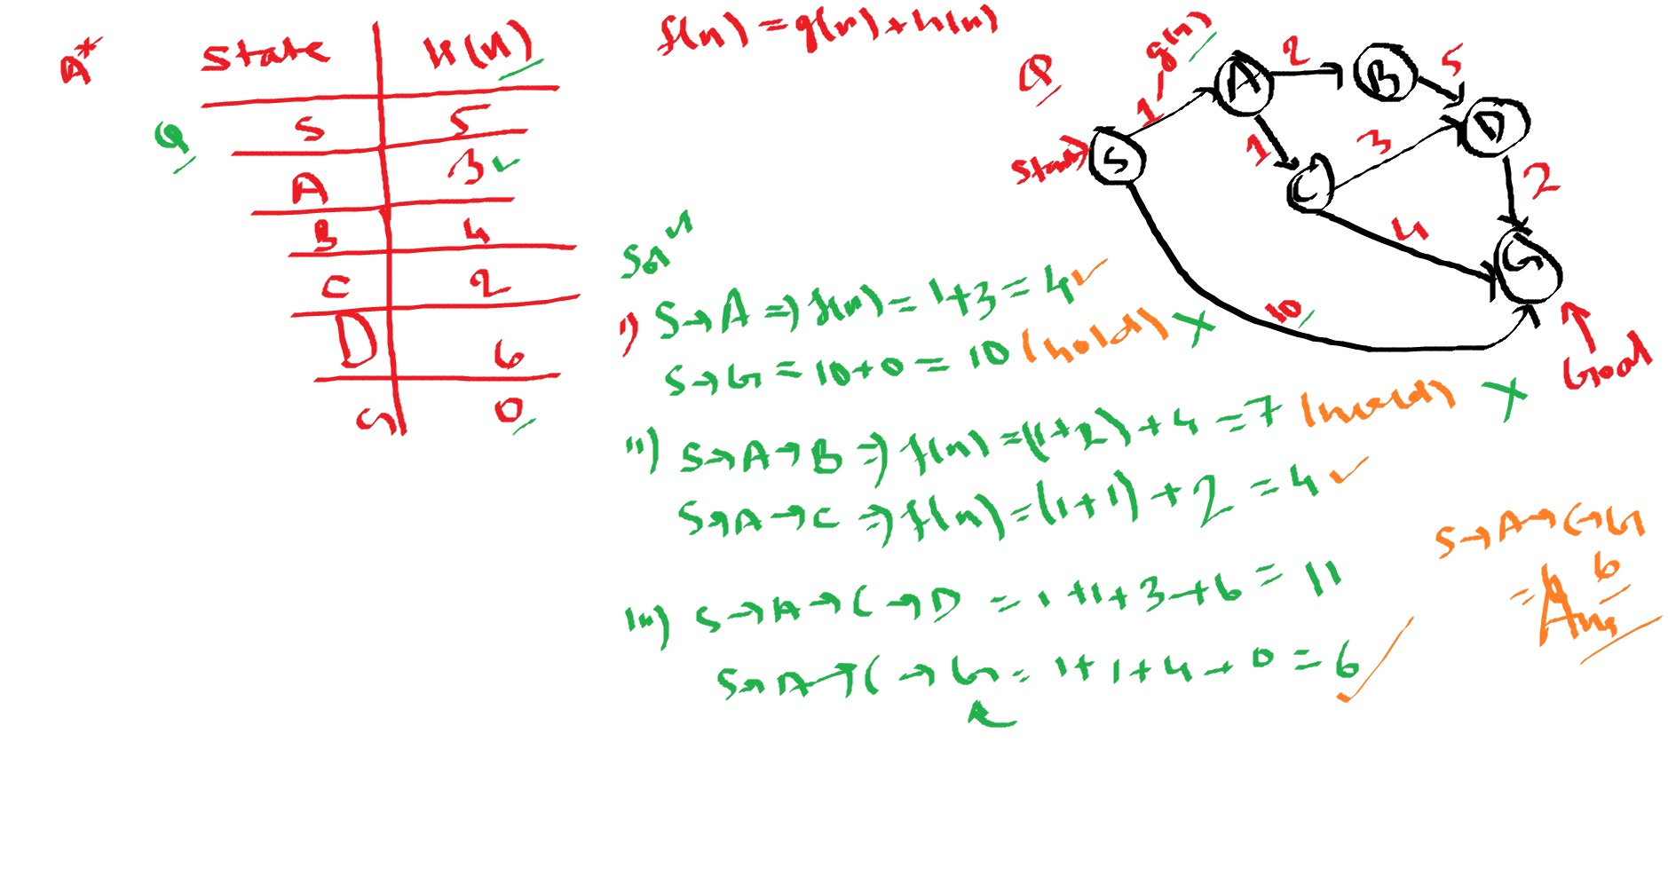

Slide 13
A* Search: Dry Run
A-5
h(n)
3
2
B-4
C-23
4
3
D-2
1
C(n,m)
E-3
20
F-0

Slide 14
OPEN
CLOSED
A(5)
A(5)
Minimum cost state in OPEN is A. Put A in CLOSED. A does not belong to G.
Initial state of OPEN and CLOSED. g(A)=0, f(A)=h(A)=5.

Slide 15
OPEN
CLOSED
A(5)
B(7) | C(25)
A(5)
A(5) | B(7)
Minimum cost state in OPEN is B. Put B in CLOSED. B does not belong to G.
Expand A to obtain B and C. B does not belong to [OPEN union CLOSED].
Therefore, set g(B)=g(A) + C(A, B) = 0 + 3 = 3.
And, set f(B) = g(B) + h(B) = 3 + 4 = 7. Place B on OPEN.
Similarly, g(C)=0 + 2 = 2 and f(C)=2+23=25. Place C in OPEN. Return to step 2.

Slide 16
OPEN
CLOSED
A(5)
B(7) | C(25)
A(5)
C(25) | D(9)
A(5) | B(7)
A(5) | B(7) | D(9)
Minimum cost state in OPEN is D. Put D in CLOSED. D does not belong to G.
Expand B to obtain D. D does not belong to [OPEN union CLOSED].
Therefore, set g(D)=g(B) + C(B, D) = 3 + 4 = 7.
And, set f(D) = g(D) + h(D) = 7 + 2 = 9. Place D in OPEN. Return to step 2.

Slide 17
OPEN
CLOSED
A(5)
B(7) | C(25)
A(5)
C(25) | D(9)
A(5) | B(7)
C(25) | E(11)
A(5) | B(7) | D(9)
A(5) | B(7) | D(9) | E(11)
Minimum cost state in OPEN is E. Put E in CLOSED. E does not belong to G.
Expand D to obtain E. E does not belong to [OPEN union CLOSED].
Therefore, set g(E)=g(D) + C(D, E) = 7 + 1 = 8.
And, set f(E) = g(E) + h(E) = 8 + 3 = 11. Place E in OPEN. Return to step 2.

Slide 18
OPEN
CLOSED
A(5)
B(7) | C(25)
A(5)
C(25) | D(9)
A(5) | B(7)
C(25) | E(11)
A(5) | B(7) | D(9)
C(25) | F(28)
A(5) | B(7) | D(9) | E(11)
A(5) | B(7) | D(9) | E(11) | C(25)
Minimum cost state in OPEN is C. Put C in CLOSED. C does not belong to G.
Expand E to obtain F. F does not belong to [OPEN union CLOSED].
Therefore, set g(F)=g(E) + C(E, F) = 8 + 20 = 28.
And, set f(F) = g(F) + h(F) = 28 + 0 = 28. Place F in OPEN. Return to step 2.

Slide 19
OPEN
CLOSED
A(5)
B(7) | C(25)
A(5)
C(25) | D(9)
A(5) | B(7)
C(25) | E(11)
A(5) | B(7) | D(9)
C(25) | F(28)
A(5) | B(7) | D(9) | E(11)
F(28) | D(7)
A(5) | B(7) | D(9) | E(11) | C(25)
A(5) | B(7) | E(11 | C(25)
Expand C to obtain D. D belongs to [OPEN union CLOSED] as it is in CLOSED.
Therefore, set g(D)=min{g(D), g(C) + C(C, D)} = min{7, 2 + 3} = 5.
And, set f(D) = g(D) + h(D) = 5 + 2 = 7. As f(D) has decreased from 9 to 7, and D belongs to CLOSED, therefore move D from CLOSED to OPEN. Return to step 2.

Slide 20
OPEN
CLOSED
A(5)
B(7) | C(25)
A(5)
C(25) | D(9)
A(5) | B(7)
C(25) | E(11)
A(5) | B(7) | D(9)
C(25) | F(28)
A(5) | B(7) | D(9) | E(11)
F(28) | D(7)
A(5) | B(7) | E(11 | C(25)
F(28)
A(5) | B(7) | E(11 | C(25) | D(7)
F(28) | E(9)
A(5) | B(7) | C(25 | D(7)
Minimum cost state in OPEN is D. Put D in CLOSED. D does not belong to G.
Expand D to obtain E. E belongs to [OPEN union CLOSED] as it is in CLOSED.
Therefore, set g(E)=min{g(E), g(D) + C(D, E)} = min{8, 5 + 1} = 6.
And, set f(E) = g(E) + h(E) = 6 + 3 = 9. As f(E) has decreased from 11 to 9, and E belongs to CLOSED, therefore move E from CLOSED to OPEN. Return to step 2.

Slide 21
OPEN
CLOSED
A(5)
B(7) | C(25)
A(5)
C(25) | D(9)
A(5) | B(7)
C(25) | E(11)
A(5) | B(7) | D(9)
C(25) | F(28)
A(5) | B(7) | D(9) | E(11)
F(28) | D(7)
A(5) | B(7) | E(11 | C(25)
F(28) | E(9)
A(5) | B(7) | C(25) | D(7)
F(26)
A(5) | B(7) | C(25) | D(7) | E(9)
F(28)
Minimum cost state in OPEN is E. Put E in CLOSED. E does not belong to G.
Expand E to obtain F. F belongs to [OPEN union CLOSED] as it is in OPEN.
Therefore, set g(F)=min{g(F), g(E) + C(E, F)} = min{28, 6 + 20} = 26.
And, set f(F) = g(F) + h(F) = 26 + 0 = 26. As f(F) has decreased from 28 to 26, but F does not belong to CLOSED, it is already in OPEN. Replace it. Return to step 2.
Minimum cost state in OPEN is F with the cost 26. F belongs to G. Therefore, return f(F)=26. This is the minimum cost of reaching the goal node F.

Slide 22
Difference between
Best first search and A* algorithm
Best-first search algorithm visits the next state based on heuristic function f(n) = h with lowest heuristic value (often called greedy). It does not consider cost of the path to that particular state. All it looks for is that which next state from the current state has lowest heuristics.
A* search algorithm visits the next state based on heuristics f(n) = h + g where h component is same heuristics applied as in Best-first search but g component is path from the initial state to the particular state. Therefore, it does not choose the next state only with lowest heuristics value but one that gives lowest value when considering it's heuristics along with the cost of getting to that state.

